Slide 1
Database Indexing for Skyline Computation, Hierarchical Relational Database, and Spatially-Aware SPARQL Evaluation Engine
Dissertation Defense Presented by
Chih-Jye Wang
Advisory Committee
Dr. Wei-Shinn Ku, Department of Computer Science, Chair
Dr. James Cross, Department of Computer Science,
Dr. Alvin Lim, Department of Computer Science,
Dr. Xiao Qin, Department of Computer Science,
Dr. Edward Thomas, Jr, Department of Physics, Reader
November 10, 2015

Slide 2
Abstract
Computer databases are ubiquitous and play an important role in many software projects. The efficiency of these systems are crucial in the applications they support. Data indexing is the key to efficient data retrieval in database systems. This dissertation considers three data application domains and operations in which data indexing can greatly improve the turnaround time of request operations.
The first is the study of multi-dimensional and multi-criteria skyline computation. Skyline is a subset of data records that are the best in a data set, where best is defined by user criteria and preference. In our technique, we first create an index using the R-Tree structure. We then propose a greedy algorithm that utilizes the R-Tree index to aggressively prune the search space as the index is traversed. Experimental evaluation shows that our algorithm performs better than previous algorithms.
In the second part of this dissertation, we considered efficiency of querying hierarchical data in relational database (hierarchical relational database). Relational database model is known to efficiently store and retrieval data store in flat tables; however, it was not designed for hierarchical data. Due to this limitation, many operations -- such as answering membership on a hierarchical data -- require recursion or iterations. In this study, we propose an index structure based on the nested-sets model. With this index, we can eliminate recursions and allow database engines to perform hierarchical operations with index scans.
In the last part of this dissertation, we considered storage and retrieval of point-based spatial data (POIs) in RDF triple stores. When we first started this study, spatial data management in RDF was still a fairly new research area and there were no standard for query spatial data using SPARQL. In this work, we designed an index scheme using the Hilbert Space-Filing Curve (HSFC). Leveraging the spatial locality of HSFC, we are able to efficiently evaluate spatial queries such as range and k-nearest-range (kNN) queries. In this work, we define range and kNN SPARQL filters. We implemented there filters and showed that our implementation handles spatial queries better than other triple stores.

Slide 3
Outline
Multi-dimensional Skyline Computation via R-Tree Spatial Index
Introduction
Related Works
IPS: Index-Based Pruning Skyline
Experimental Evaluation
MDPX and Hierarchical Relational Database
Introduction to MDPX and MDPX Database
Related Works
Hierarchical Relational Database and Nested Sets Model
Performance Evaluation
Geo-Store: A Spatially-Aware SPARQL Evaluation Engine
Introduction to Semantic Web, RDF, and SPARQL
Spatial-Aware RDF index
Experimental Results

Slide 4
Spatial Index Pruning Skyline Computation

Slide 5
Introduction and Motivation

Slide 6
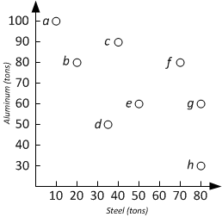

Skyline Operation
Skyline computation has broad applications
Finding the most efficient points of a data set in database
In Economics, Production Possibility Frontier (PPF) is a Skyline problem
An instance is defined as (T, σ)
T: the data set (a set of tuples)
σ: an set of minimizing/maximizing specifiers (min, max, ..)
Example: We have a set of foundries that produce both steel and aluminum, and amount produced per month.
We want to maximize both steel and aluminum. How to find the most efficient factories?
Producer | Steel | Alu
a | 10 | 100
b | 20 | 80
c | 40 | 90
d | 30.5 | 50
e | 50 | 60
f | 70 | 80
g | 80 | 60
h | 80 | 30
Production Posibility Frontier (PPF)

Slide 7
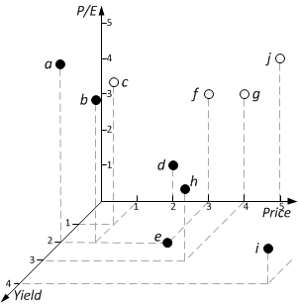
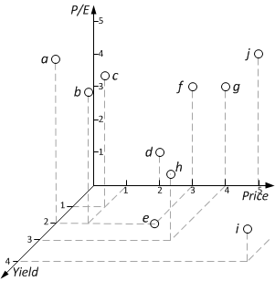
Multi-Dimensional Skyline
Stock data
Minimize
Maxi-mize
Symbol | Price ($) | P/E | Yield (%)
a | 0 | 5 | 2
b | 1 | 4 | 2
c | 1 | 4 | 1
d | 2 | 2 | 0
e | 3 | 0 | 2
f | 3 | 3 | 0
g | 4 | 3 | 0
h | 4 | 2 | 3
i | 7 | 1 | 4
j | 5 | 4 | 0

Slide 8
Motivation and Research Goal
The current techniques have disadvantages:
Do not consider combinations minimizing or maximizing of attributes
Do no address skyline computation for data of arbitrary dimensions
Research Goal
Efficiency: support efficient and flexible skyline computation through indexing
Flexibility: algorithm allows arbitrary min and max preferences over attributes
Data Width: support data of high dimension(number of attributes)

Slide 9
Related Works

Slide 10
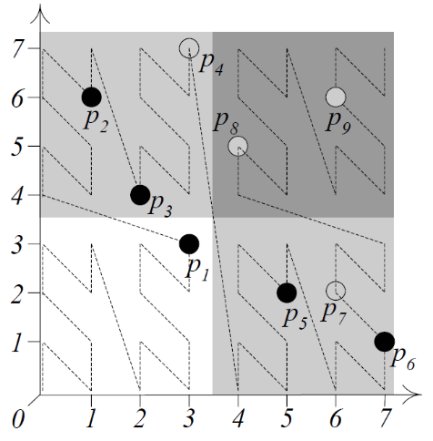
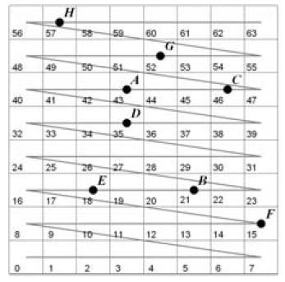
Z and Sweep Space Filling Curve
Z-Order SFC ^{[1]}
Sweep SFC ^{[2]}
Procedure
Hash data points to an integer value based on the property (order) of the SFC
Index the hash values in another data structure (such as a B-Tree) to facilitate Skyline Computation
Drawbacks
Impractical for combinations minimizing and maximizing of attributes
Computation/re-computation of Z-Curve sequence could be time consuming
Ken C. K. Lee, Baihua Zheng, Huajing Li, and Wang‐Chien Lee. 2007. Approaching the skyline in Z order. In Proceedings of the 33rd international conference on Very large data bases (VLDB '07). VLDB Endowment 279‐290. http://dl.acm.org/citation.cfm?id=1325886
JongWoo Ha, Yoon Kwon, Jae‐Ho Choi, and SangKeun Lee. Energy Efficient and Progressive Strategy for Processing Skyline Queries on Air. In DEXA, pages 486–500, 2009.

Slide 11
Nearest Neighbor^{[1]}
Procedure:
Find the nearest record from the origin
Makes and insert one pruning region
Insert d additional search spaces to to-do list
Drawback
The to-do (search) list could get large for high dimension data
Dimitris Papadias, Yufei Tao, Greg Fu, and Bernhard Seeger. Progressive skyline computation in database systems. ACM Trans. Database Syst., 30(1):41–82, 2005.

Slide 12
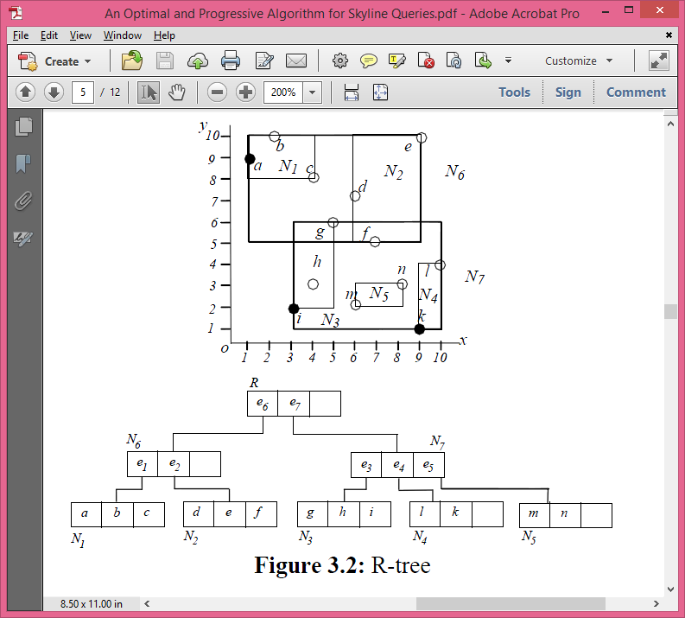
Branch and Bound Skyline (BBS)^{[1]}
Indexing using R-Tree and perform greedy expansion
The best algorithm for searching Skyline
However, it only starts pruning when a skyline point is found
In this presentation, we also call this record-based pruning skyline (RPS)
Dimitris Papadias, Yufei Tao, Greg Fu, and Bernhard Seeger. Progressive skyline computation in database systems. ACM Trans. Database Syst., 30(1):41–82, 2005.

Slide 13
Index-Based Pruning Skyline

Slide 14
IPS Overview
Indexing: index data points using R-Tree
Group data points into Minimum Bounding Rectangles (MBR), defined by points (min, max)
Recursively grouping MBRs into larger MBRs
We get an index tree
Query evaluation: compute skylines
Use greedy expansion of the index
Aggressively prune the search space using pruning regions

Slide 15
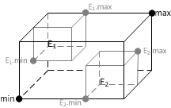
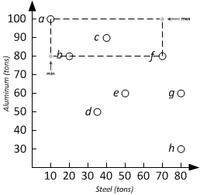
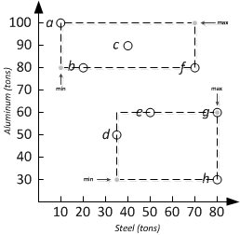
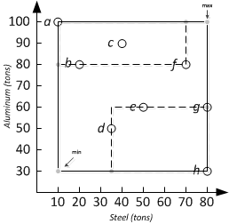
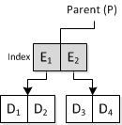
Creating R-Tree Index

Slide 16
IPS Algorithm
Use greedy expansion of the index
Find the nearest MBR using MINDIST
Insert MBRs into a Priority Queue (min heap)
Use Mindist as queue priority
Update pruning region after insert
Expand the next node on the priority queue
Algorithm ends when the heap is empty

Slide 17
IPS Algorithm

Slide 18
IPS Algorithm Example
b
a
c
d
Queue:
A
A2
B
A1
B
B2
Results:
a
b
c
d

Slide 19
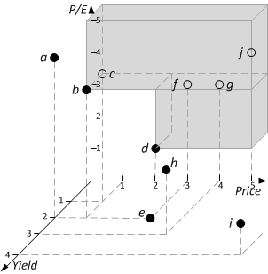
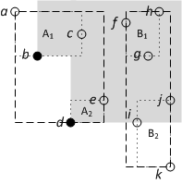
Pruning Region
A region in data space that can be pruned from searching
Regions that cannot contain skyline points, since it’s dominated by one or more data items
Minimize all attributes
Minimize: P/E, Price
Maximize: Yield

Slide 20
Experimental Evaluation

Slide 21
Evaluation Data
Synthetic generated data points
Data point distribution
Uniformed: data uniformly distributed in the search space
Rising: the attributes are correlated to the first attribute
Falling: the attribute are inversely correlated to the first attribute
Date Size
Record count: 20,000 to 100,000
Dimension: 2 to 10

Slide 22


Evaluation Data
Uniform; 10,000 points, 2-dimensional

Slide 23

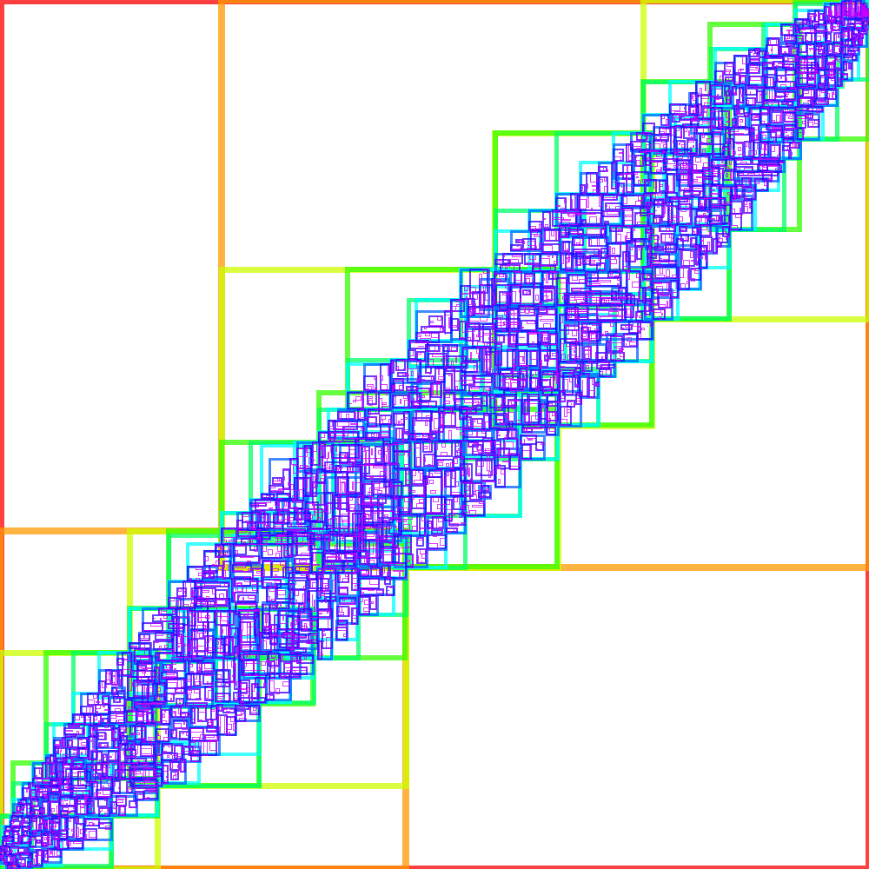
Evaluation Data
Rising; 10,000 points, 2-dimensional

Slide 24
Evaluations
Dominance Test: how many dominance comparisons performed by the algorithm
Index Percentage: space overhead taken by the index in our data serialization technique

Slide 25
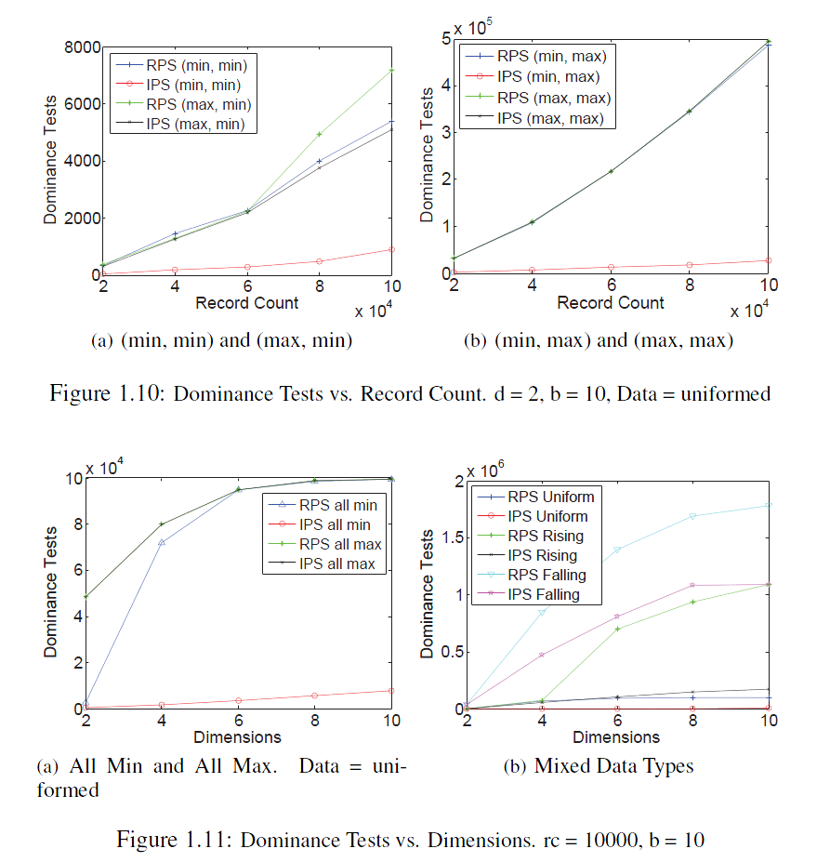
Dominance Tests

Slide 26
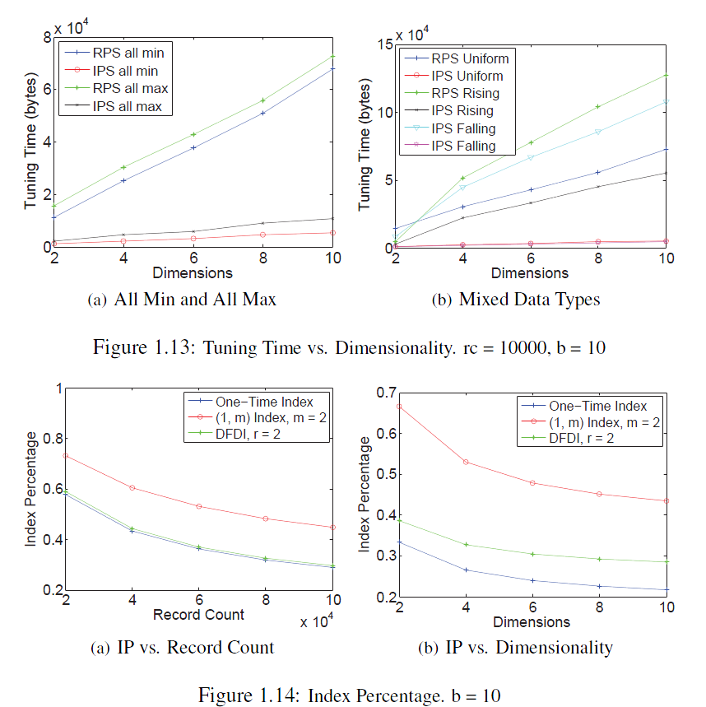
Index Overhead

Slide 27
Conclusion
IPS is able to handle multi-dimensional data record
IPS is flexible to answer arbitrary criteria skyline queries
IPS is more efficient than RPS
Our serialization technique is efficient and able to support broadcast environment

Slide 28
Community Contribution
Chih-Jye Wang and Wei-Shinn Ku, “Efficient Evaluation of Skyline Queries in Wireless Data Broadcast Environments,” In Proceedings of the 20th ACM SIGSPATIAL International Conference on Advances in Geographic Information Systems (ACM SIGSPATIAL GIS), Redondo Beach, CA, USA, 2012.
Jang, Miyoung, Min Yoon, and Jae-Woo Chang. "A New Query Integrity Verification Method with Cluster-based Data Transformation in Cloud Computing Environment." International Journal of Smart Home 9.4 (2015).
Jang, Miyoung, et al. "Clustering-Based Query Result Authentication for Encrypted Databases in Cloud." High Performance Computing and Communications, 2014 IEEE 6th Intl Symp on Cyberspace Safety and Security, 2014 IEEE 11th Intl Conf on Embedded Software and Syst (HPCC, CSS, ICESS), 2014 IEEE Intl Conf on. IEEE, 2014.
Jang, Miyoung, Ara Jo, and Jae-Woo Chang. "A privacy-aware query authentication index for encrypted database in cloud." Internet Technology and Secured Transactions (ICITST), 2013 8th International Conference for. IEEE, 2013.
Jang, Miyoung, Ara Jo, and Jae-Woo Chang. "Encrypted Data Group Authentication for Outsourced Databases." Ubiquitous Computing Application and Wireless Sensor. Springer Netherlands, 2015. 695-705.
Liu, Chuan-Ming, and Kai-An Yu. "Effective Skyline Query Execution in Wireless Broadcast Environments." Database and Expert Systems Applications. Springer International Publishing, 2014.
游凱安. "在廣播環境下提供針對位置相關的天際線查詢協定." (2013).

Slide 29
MDPX and Hierarchical Relational Database

Slide 30
Magnetized Dusty Plasma Experiment (MDPX)^{[1]}
Advanced plasma experiment facility
Directed by Dr. Edward Thomas, Jr. started around 2013
Multi-institutional, lead by Auburn University
Consists many devices that requires software control and coordination
Great opportunity to learn information management and control sys of scientific apps
E. Thomas, Jr., U. Konopka, D. Artis, B. Lynch, S. Leblanc, S. Adams, R. L. Merlino, and M. Rosenberg. The magnetized dusty plasma experiment (mdpx). Journal of Plasma Physics, FirstView:1–21, 3 2015.

Slide 31
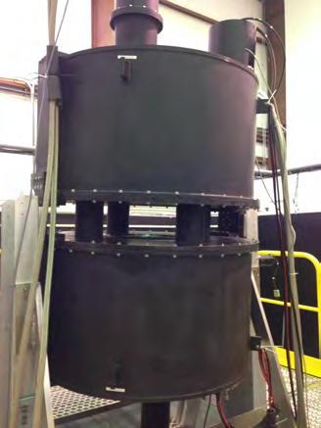
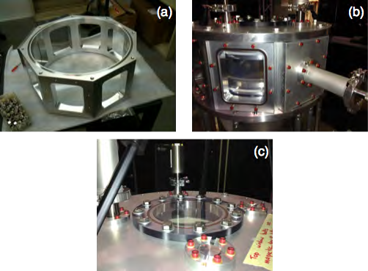
Some Pictures^{[1]}
E. Thomas, Jr., U. Konopka, D. Artis, B. Lynch, S. Leblanc, S. Adams, R. L. Merlino, and M. Rosenberg. The magnetized dusty plasma experiment (mdpx). Journal of Plasma Physics, FirstView:1–21, 3 2015.
https://www.youtube.com/watch?v=UUudF9pZV3k

Slide 32
MDPX Control and Data Acquisition
Computer Control System^{[1]}
LabView^{[2]} control software
Communication with physical devices through National Instruments PXIe-1075 Chassis
Data is taken by LabView software and archived in various forms
Data Storage
Disk storage: raw measurements, image and video files
Searchable catalog: relational database
E. Thomas, Jr., U. Konopka, D. Artis, B. Lynch, S. Leblanc, S. Adams, R. L. Merlino, and M. Rosenberg. The magnetized dusty plasma experiment (mdpx). Journal of Plasma Physics, FirstView:1–21, 3 2015.
National Instruments. Labview system design software. http://www.ni.com/labview/, November 2015.

Slide 33
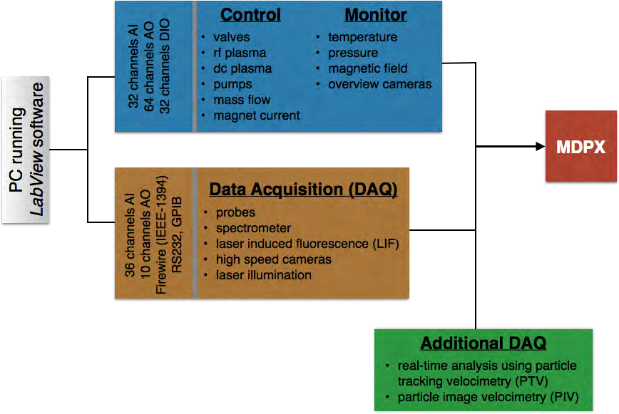
MDPX Control and Data Acquisition
Web Viewer
Relational Database
Disk Storage

Slide 34
Relational Database
Searchable experiment metadata
Experiment date, researcher, operator
Experiment configuration
Which parts are used
How are parts connected (parts hierarchy)
Summary data
Parts Catalog
Part number and serial number

Slide 35
Related Works

Slide 36
Experiments and Control Systems
Name | Start | End | Type | Institution | Location | Hardware | Software | Data Management
Alcator C-Mod | 1991 |  | Tokamak | MIT | Cambridge, Massachusetts | CPCI, PCI | Linux, IDL | MDSPlus
ASDEX Upgrade | 1991 |  | Tokamak | Max Planck Institute of Plasma Physics (IPP) | Garching, Germany
DIII-D | 1980 |  | Tokamak | General Atomics | San Diego, CA | CAMAC, Motorola 68030, LeCroy FERA | VMEexec real-time system, Unix | Disk
EAST | 2006 |  | Tokamak | Chinese Academy of Science | Anhui, China
JET | 1984 |  | Tokamak | European Union | Oxfordshire, UK | CAMAC | Solaris, C | Disk
KSTAR | 2008 |  | Tokamak | National Fusion Research Institute | Daejon, South Korea
LHD | 1998 |  | Helical Stellarator | National Institute for Fusion Science | Toki, Gifu, Japan | CPCI, NI, Yokogamwa | Windows, Linux | ODBMS
NSTX | 1999 |  | Spherical Tokamak | Princeton Plasma Physics Laboratory (PPPL) | Princeton, New Jersey | CAMAC, UNIX, Windows | Solaris, EPICS, PCS | MDSPlus
TFTR | 1982 | 1997 | Tokamak | Princeton Plasma Physics Laboratory (PPPL) | Princeton, New Jersey | CAMAC |  | Disk
TJ-I | 1983 | 1995 | Tokamak | Fusion Laboratory of Spain (CIEMAT) | Madrid, Spain
TJ-II | 1997 |  | Helical Stellarator | Fusion Laboratory of Spain (CIEMAT) | Madrid, Spain
Wendelstein 7-AS | 1988 | 2002 | Stellarator | Max Planck Institute of Plasma Physics (IPP) | Garching, Germany
Wendelstein 7-X | 2004 |  | Stellarator | Max Planck Institute of Plasma Physics (IPP) | Garching, Germany

Slide 37
MDSPlus
Characteristics
Hierarchical database designed to keep data of fusion experiments
Customizable and programmable using Tree Command Language (TCL), and others
Disadvantages
It’s old: does not take into account of recent database advancements
No standard query language
Data traversal, insertion, and modification has to be done using TCL commands

Slide 38
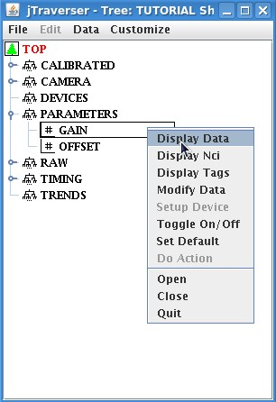
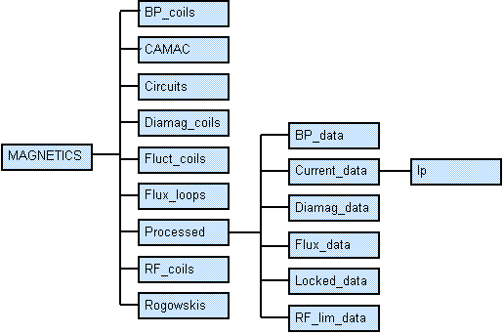
MDSPlus
MDSPlus Documentation and Tutorial, MDSPlus, http://www.mdsplus.org/index.php?title=Documentation:Tutorial:QuickOverview%20&open=41338000618048318341119&page=Documentation%2FThe+MDSplus+tutorial%2F+A+Quick+Tour+over+MDSplus+Basic+Concepts

Slide 39
MDSPlus
TCL> edit my_tree
TCL> add node .SUB1 #Create a new subtree. Note that the name is preceded by a dot.
TCL> set def .SUB1 #Move into SUB1 subtree. Much like the UNIX cd command.
TCL> add node SUB_NODE1/usage=numeric #Add empty node SUB_NODE1 to subtree SUB1.
TCL> add node .SUB2 # Create subtree SUB2
TCL> set def .SUB2 #Move into SUB2 subtree
TCL> add node SUB_NODE2/usage=text # Add empty node SUB_NODE2 to subtree SUB2.
TCL> write # Write the newly created tree
TCL> close # Close the tree.
MDSPlus Documentation and Tutorial, MDSPlus, http://www.mdsplus.org/index.php?title=Documentation:Tutorial:QuickOverview%20&open=41338000618048318341119&page=Documentation%2FThe+MDSplus+tutorial%2F+A+Quick+Tour+over+MDSplus+Basic+Concepts

Slide 40
EPICS^{[1]}
Maintain by Advanced Photon Source (APS) at Argonne National Laboratory (Chicago)
Distributed control system for extremely large experiments
Uses client-sever architecture
Any device (such as diagnostics) can be a server that publishes a variable
Variables can be read or set by clients that have permission
Advance Photon Source Argonne National Laboratory. Experimental physics and industrial control system. http://www.aps.anl.gov/epics, February 2015.
Andrew Johnson. Introduction to epics. http://www.aps.anl.gov/epics/docs/APS2014/01-Introduction-to-EPICS.pdf, September 2014.

Slide 41
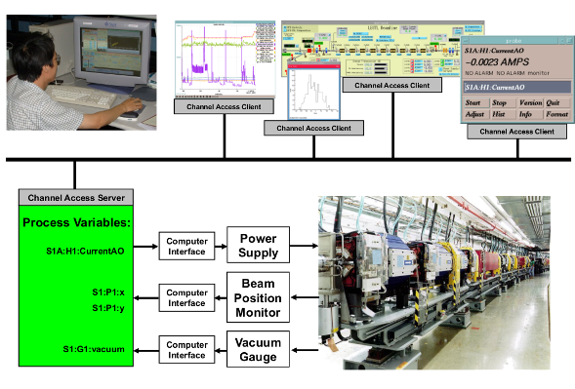
EPICS
Advance Photon Source Argonne National Laboratory. Experimental physics and industrial control system. http://www.aps.anl.gov/epics, February 2015.
Andrew Johnson. Introduction to epics. http://www.aps.anl.gov/epics/docs/APS2014/01-Introduction-to-EPICS.pdf, September 2014.

Slide 42
Hierarchical Relational Database

Slide 43
Motivation
Hierarchical data (trees) often needed to be stored and queried in relational database^{[9]}
Example: Bill of material (or parts)
Relational database are essentially flat tables
Most techniques (of storing tree) require recursion (multiple queries) to retrieve hierarchy
Goal: Design an index technique to eliminating recursion to improve query performance

Slide 44
Operations
Given two nodes, n₁, n₂, of a tree, the following are common operations
Parent(n₁): find the parent node of n₁
Member(n₁, n₂): if n₁ is a descendent of n₂
Tree(n₁): gets the entire tree structure (all descendant nodes) of n₁
Root(n₁): gets the root node of n₁

Slide 45
Known Techniques
Adjacency List
Each data record (node) has a reference back to its parent record (parent node)
Path enumeration
Each data record maintains a complete route from the root node to the current node

Slide 46
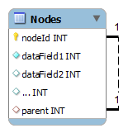
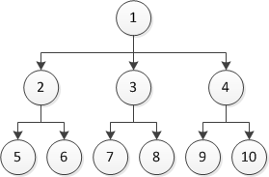
Adjacency List
Most intuitive representation
Also known as Parent-Link model
CREATE TABLE Nodes (
nodeId INT PRIMARY KEY NULL,
-- Any number of data fields
parent INT NOT NULL,
FOREIGN KEY (parent) REFERENCES Nodes(ID)
)
nodeId | parent
1 | null
2 | 1
3 | 1
4 | 1
5 | 2
6 | 2
7 | 3
8 | 3
9 | 4
10 | 4

Slide 47
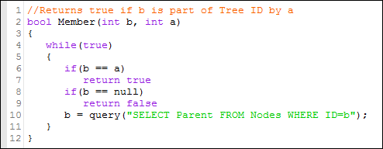
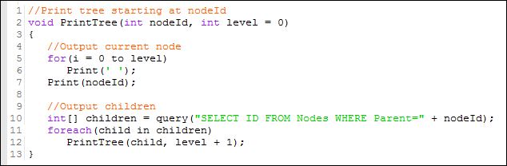
Query via Adjacency List
Member
Loop
Print Tree
Recursion

Slide 48
Path Enumeration
Path attribute denote the position of a node
nodeId | path
1 | 1
2 | 1/2
3 | 1/3
4 | 1/4
5 | 1/2/5
6 | 1/2/6
7 | 1/3/7
8 | 1/3/8
9 | 1/4/9
10 | 1/4/10
Does not need recursion, but
Require text-processing on client
Each record incurs extra transmission overhead

Slide 49
Support in Current Systems
Currently Limited and only very few systems have any support hierarchical data
Most systems do not have hierarchical syntax or functions
Support Systems
Oracle Database Systems^{[1]}
Supports nonstandard SQL syntax CONNECT BY
Still depends on recursion
Microsoft SQL Server^{[2,3]}
Supports ‘hierarchyid’ field type (since 2008)
Implement encoded path-enumeration model

Slide 50
Hierarchical Relational Database with Multi-Nested Sets

Slide 51
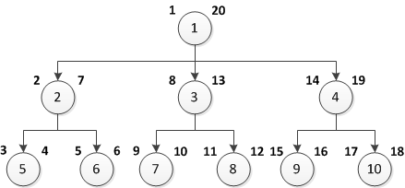
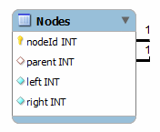
Proposed Design with Nested Set^{[5]}
An extension of adjacency list model
Two additional fields, left(L) and right(R), to denote hierarchical relationship

Slide 52
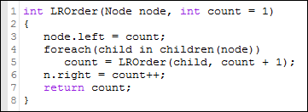
Nested Set Order Assignment
Left-Right value assignment procedure:
Steps:
Assign count to left of node n
For each child of node n, call LROrder for that child
After LROrder call is complete for each children, incement and assign count to the right value of current node

Slide 53
LR Value and Node Relationship
Given two nodes n₁, n₂ of a tree
Relationship | Conditions | SQL Query
n₁ is ancestor of n₂ | n₁.left < n₂.left and n₁.right > n₂.right | Get all ancestors of n₁: SELECT * FROM Nodes WHERE left < n1.left AND right > n1.right
n₁ is member (descendant) of n₂ | n₁.left ≥ n₂.left and n₁.right ≤ n₂.right | Get the entire tree root at n₁: SELECT * FROM Nodes WHERE (left > n1.left OR left = n1.left) AND (right < n1.right OR right = n1.right)

Slide 54
Nested Set is great but..
We can still make queries faster by designing a index for hierarchical data.
Using comparison operators in query is cumbersome and error-prone. We can design SQL extension that utilize our index.

Slide 55
Solution: Index!
LR values managed by the RDBMS (instead of the users)
Alleviate the user from having to use comparison operator
‘HIE’ attribute flag to designate a table as hierarchical
The table must have a ‘parent’ attribute
Index!: Using 2 B-Trees^{[4]}
one for left-value and one for right value
Speeds up LR-value look up
Implement hierarchical operators using the index

Slide 56
Unsolved Design Issues
Node insertion
Should we reassign all LR values?
Leave some space for new nodes?
What is the best data type for LR values?
Integers?
Real numbers?
LR value split algorithm

Slide 57
Performance Evaluation

Slide 58
Environment Configuration
Server configuration
Client Configuration
CPU | Intel Processor 64-bit
Memory | 4 GB
Operating System | Ubuntu Desktop 13.10
Database System | MySQL 5.5 Community Edition
CPU | Intel Processor 64-bit
Memory | 12 GB
Operating System | Ubuntu Desktop 13.10
Programming Language | Java 7 (OpenJDK 7)
Database Connector | JDBC mysql-connector-java-5.1.29

Slide 59
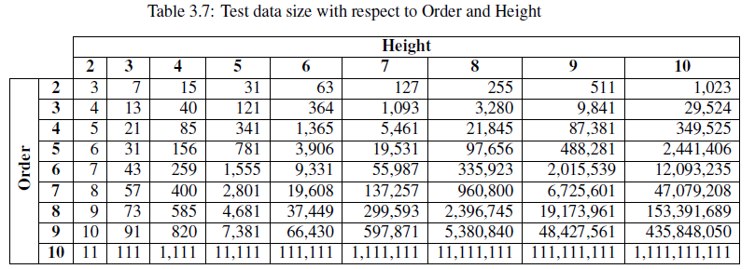
Experiment Data
Synthetically generated relational tree hierarchies
Data Properties
Order: the number of children per node
Height: the height of the longest path

Slide 60
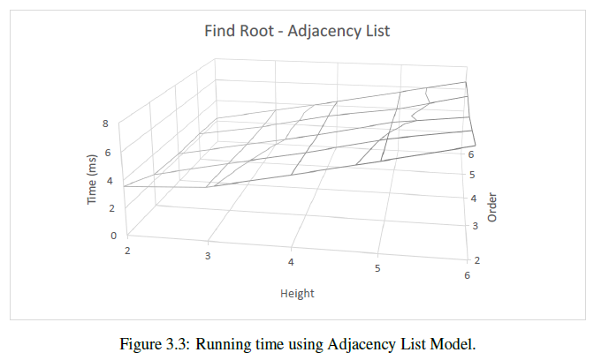
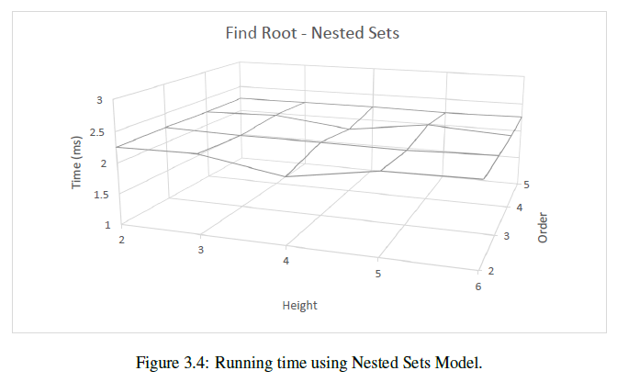
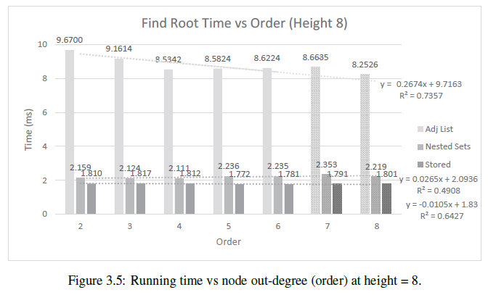
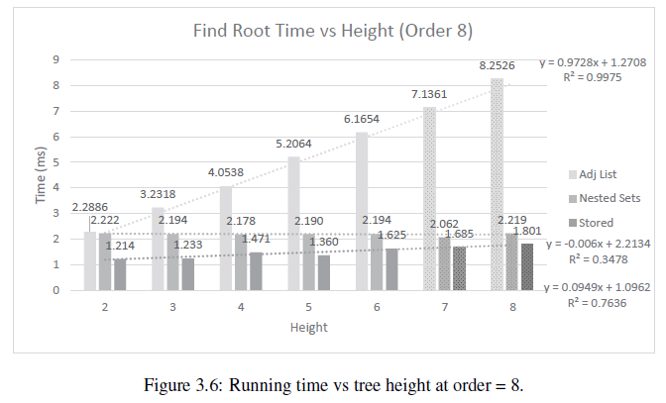
Find Root

Slide 61
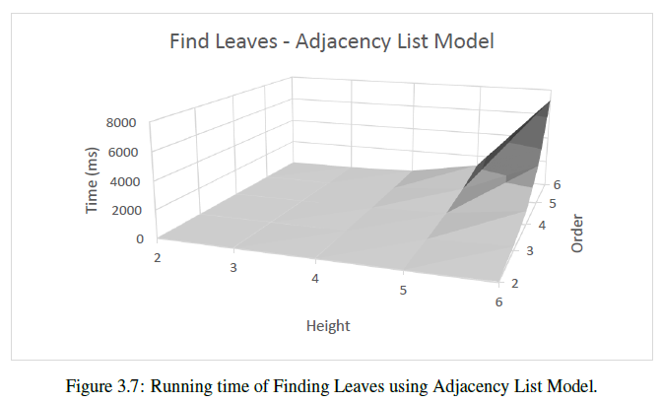
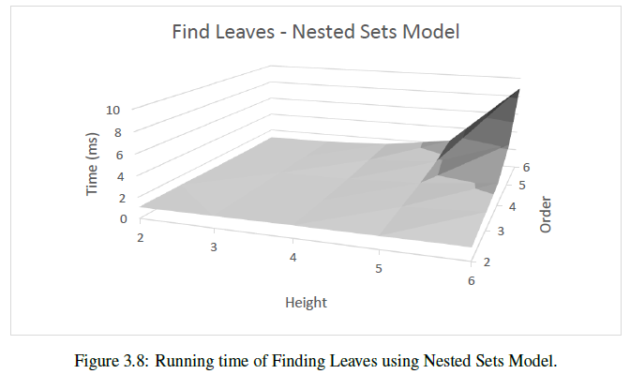
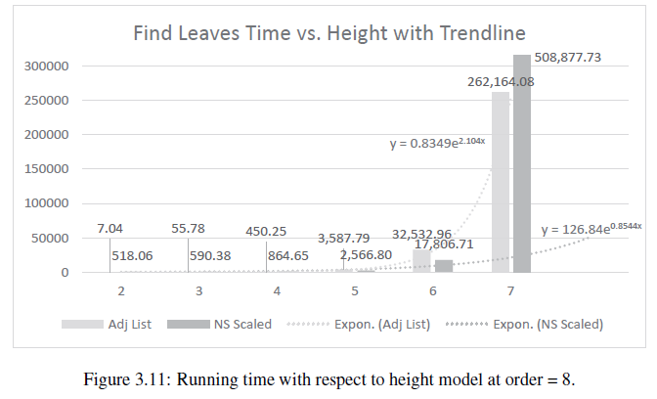
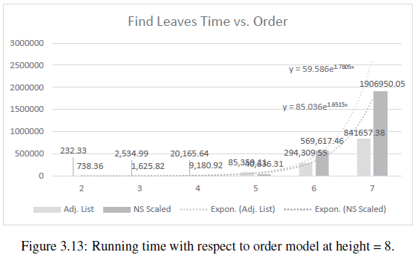
Find Leaves

Slide 62
GeoStore: A Spatially-Aware SPARQL Evaluation Engine

Slide 63
Introduction

Slide 64
Semantic Web
The dominant database system on the web is relational database and structured data
As data on the web grew, it’s harder to store data in structured way
Semantic web is a collection of standards and technologies that allow merging and utilizing data from different sources
Example: a database of celebrities

Slide 65
Resource Description Framework (RDF)
A data model for semantic web data
Describe entities (resources)
Everything is an entity: people, books
Schema-free or schema flexible
Each statement consists of
Subject (S): the entity to be described
Predicate (P): the property describing the subject
Object (O): the value for this property

Slide 66
RDF Example
<john_doe> | <name> | “John Doe”
<john_doe> | <knows> | <jane_smith>
<john_doe> | <knows> | <jack_lee>
<john_doe> | <likes> | <movie_123>
<jane_smith> | <name> | “Jane Smith”
<jane_smith> | <bday> | “1989/12/4”
<jane_smith> | <knows> | <robert_doe>
<jack_lee> | <name> | “Jack Lee”
<jack_lee> | <knows> | <robert_doe>
<jack_lee> | <sibling> | <matt_lee>
<movie123> | <title> | “The Terminator”
<movie123> | <year> | “1984”

Slide 67
SPARQL
Query language for RDF
Similar to SQL
Designed for querying graph patterns
Since RDF forms graph(s)
Bind graph pattern to ?variables
Filters on variables
Comparison
Regular expressions

Slide 68
SPARQL Examples
<john_doe> | <name> | “John Doe”
<john_doe> | <knows> | <jane_smith>
<john_doe> | <knows> | <jack_lee>
<jane_smith> | <name> | “Jane Smith”
<jane_smith> | <bday> | “1989/12/4”
<jane_smith> | <knows> | <robert_doe>
<jack_lee> | <name> | “Jack Lee”
<jack_lee> | <knows> | <robert_doe>
<jack_lee> | <sibling> | <matt_lee>
<matt_lee> | <name> | “Matt Lee”
1. Query: show the name of all entities:
2. Query: show name of all entities containing “Lee”:
3. Query: show the name of friends of “John Doe”:
select ?e ?name where {
?e <name> ?name
}
select ?e ?name where {
?e <name> ?name .
filter(?name, “Lee”)
}
select ?friend ?name where {
<john_doe> <knows> ?friend .
?friend <name> ?name
}
?e | ?name
<john_doe> | John Doe
<jack_lee> | Jack Lee
<jane_smith> | Jane Smith
?e | ?name
<jack_lee> | Jack Lee
<matt_lee> | Matt Lee
?friend | ?name
<jack_lee> | Jack Lee
<jane_smith> | Jane Smith

Slide 69
Research Goal
Design an index to efficiently query point-based spatial data (POIs)
Encoding coordinates using Hilbert Space Filling Curve (HSFC)
Use aggressive index
Implement spatial SPARQL filters
Range query
K nearest neighbor (kNN) query

Slide 70
Data Preprocessing

Slide 71
Data Encoding and Indexing
Encode POIs with Hilbert Space Filling Curve (SFC)
Maintain spatial locality
Augment RDF data with additional statement for the SFC encoding
Hash long strings into integer
Index all data with 6 indexes
SPO, SOP, PSO, POS, OSP, OPS
This gives us fast SPARQL evaluation
Reverse dictionary: translate integer back to string

Slide 72
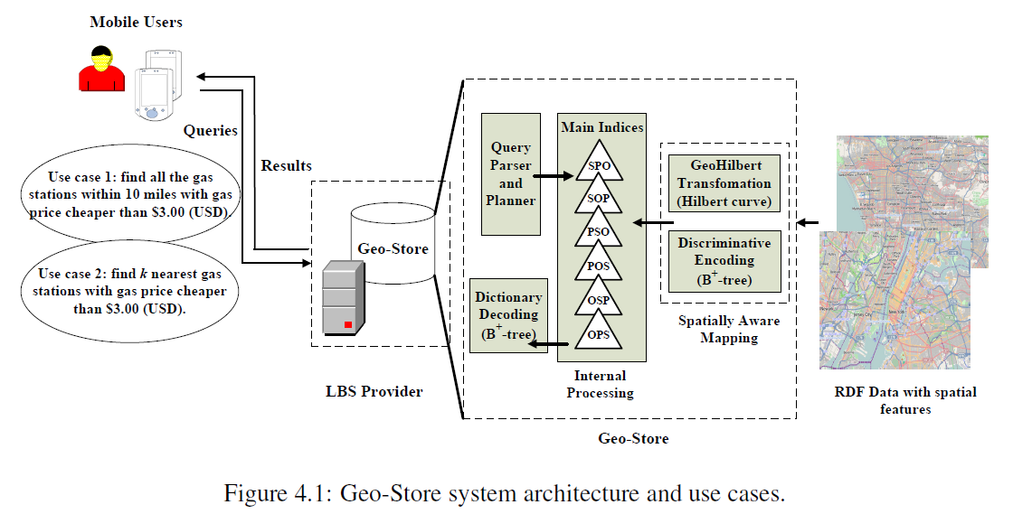
Architecture

Slide 73
Data Example
gstore:Point738330640 gml:amenity "restaurant"
gstore:Point738330640 gml:cuisine "american"
gstore:Point738330640 gml:name "Colonial Kitchen"
gstore:Point738330640 gml:pos "34.1135498 -118.1235345"
gstore:Point738330640 gstore:Pos "208083"

Slide 74
Query Evaluation

Slide 75
Spatial Filters
Range Query
Given a query point, q, and range of distance
Find all POIs that are within the range of the query point
K Nearest Neighbor Query (kNN)
Given a query point, q, and an integer, k
Find k POIs that are closest to q

Slide 76
Spatial Filters in SPARQL
Range Query
SELECT ?coordinates
WHERE {
?point a "Gas Station" .
?point gml:pos ?coordinates .
FILTER(gstore:range(?point, CURRENT_LOCATION, 10, "mile"))
?point gstore:gaspriceUSD ?price .
FILTER(?price < 3.00)
}
kNN Query
SELECT ?coordinates WHERE {
?point a "Gas Station" .
?point gml:pos ?coordinates .
FILTER(gstore:NN(?point, CURRENT_LOCATION, k))
?point gstore:gaspriceUSD ?price .
FILTER(?price < 3.00)
}

Slide 77
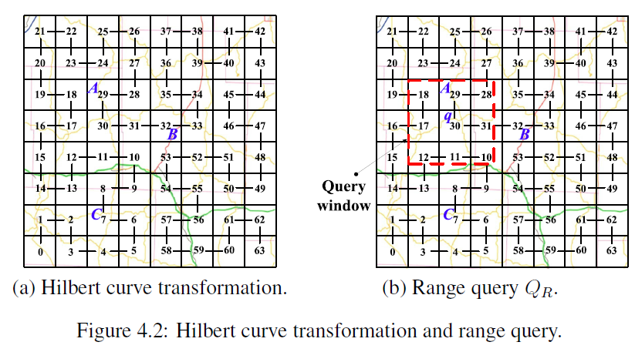
Range Filter
Find all segments of Hilbert curve values that fall into the range query
Perform search for POIs that have these Hilbert curve values
Finally, filter returned POI by calculating the distance between the query point and each POI

Slide 78
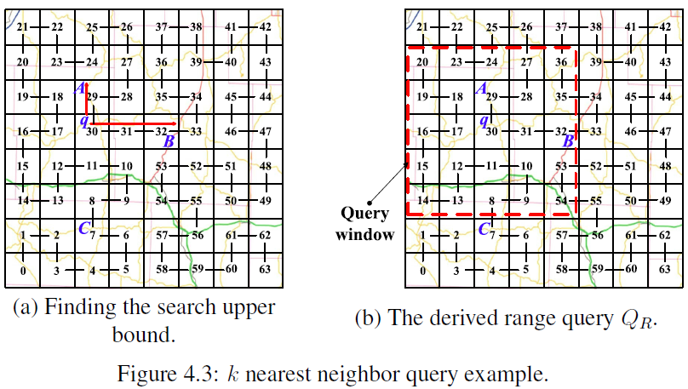
kNN Query
From query point, q, search the Hilbert curve values in both ascending and descending directions until k POIs have been found
Find the farthest object, o, from q
Perform a range query with range of distance from q to o

Slide 79
Experiment Evaluation

Slide 80
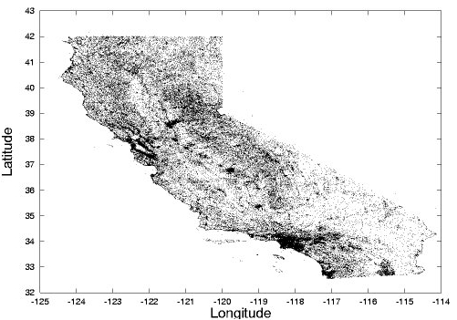
Data Set
Real data set of over 100,000 POIs in California from University of Ohio and U.S. Geological Survey^{[1]}
Each POI contains: type, latitude, longitude
Real Datasets for Spatial Databases: Road Networks and Points of Interest https://www.cs.utah.edu/~lifeifei/SpatialDataset.htm

Slide 81
Procedure
Range Query
Random query point
Range as percentage of area of California: 0.01% - 0.1%
Run 500 iterations and take the average
kNN Query
Random query point
K from 1 – 10
Run 500 iterations and take the average

Slide 82
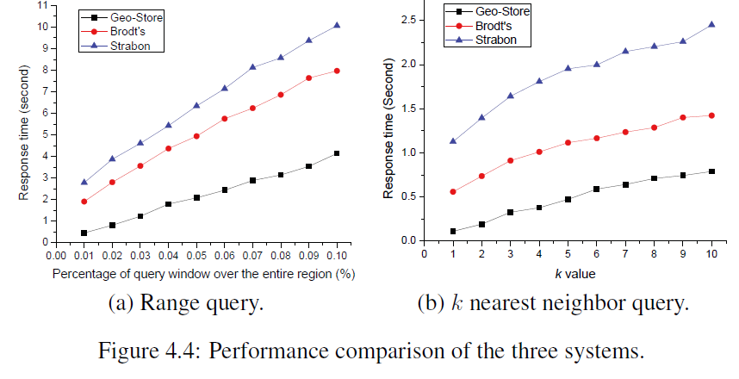
Experiment Result

Slide 83
References
Oracle database SQL Reference: Hierarchical Queries, http://docs.oracle.com/cd/B19306_01/server.102/b14200/queries003.htm
Hierarchical Data (SQL Server), http://msdn.microsoft.com/en-us/library/bb677173.aspx
hierarchyid (Transact-SQL), http://msdn.microsoft.com/en-us/library/bb677290.aspx
B-Tree Wikipedia: http://en.wikipedia.org/wiki/B-tree
Michael Kamfonas. Recursive hierarchies: The relational taboo! The Relational Journal.
Ken C. K. Lee, Baihua Zheng, Huajing Li, and Wang-Chien Lee. 2007. Approaching the skyline in Z order. In Proceedings of the 33rd international conference on Very large data bases (VLDB '07). VLDB Endowment 279-290. http://dl.acm.org/citation.cfm?id=1325886
JongWoo Ha, Yoon Kwon, Jae-Ho Choi, and SangKeun Lee. Energy Efficient and Progressive Strategy for Processing Skyline Queries on Air. In DEXA, pages 486–500, 2009.
Dimitris Papadias, Yufei Tao, Greg Fu, and Bernhard Seeger. Progressive skyline computation in database systems. ACM Trans. Database Syst., 30(1):41–82, 2005.
Saleslogix Developer, http://www.slxdeveloper.com/page.aspx?action=viewarticle&articleid=92
E. F. Codd. A relational model of data for large shared data banks. Commun. ACM, 13(6):377–387, 1970.

Slide 84
Publications
Chih-Jye Wang, Wei-Shinn Ku, and Haiquan Chen. 2012. Geo-Store: a spatially-augmented SPARQL query evaluation system. In Proceedings of the 20th International Conference on Advances in Geographic Information Systems (SIGSPATIAL '12). ACM, New York, NY, USA, 562-565. DOI=http://dx.doi.org/10.1145/2424321.2424416
Wei-Shinn Ku, Haiquan Chen, Chih-Jye Wang, and Chuan-Ming Liu, “Geo-Store: A Framework for Supporting Semantics Enabled Location-Based Services with RDF Triple Stores,”IEEE Internet Computing (IC), Vol. 17, No. 2, pp. 35-43, 2013.

Slide 85
Cited By
Liagouris, John, Nikos Mamoulis, Panagiotis Bouros, and Manolis Terrovitis. "An effective encoding scheme for spatial RDF data." Proceedings of the VLDB Endowment 7, no. 12 (2014): 1271-1282. http://dl.acm.org/citation.cfm?id=2733000
Liagouris, John, Nikos Mamoulis, Panagiotis Bouros, and Manolis Terrovitis.Efficient Management of Spatial RDF Data. Technical Report TR-2014-02, CS Department, HKU, www. cs. hku. hk/research/techreps, 2014. http://www.cs.hku.hk/research/techreps/document/TR-2014-02.pdf
Patroumpas, Kostas, Giorgos Giannopoulos, and Spiros Athanasiou. "Towards GeoSpatial semantic data management: strengths, weaknesses, and challenges ahead." In Proceedings of the 22nd ACM SIGSPATIAL International Conference on Advances in Geographic Information Systems, pp. 301-310. ACM, 2014. http://dl.acm.org/citation.cfm?id=2666410

